Slide 1
BLIZZARD
PROCUREMENT PROJECT

Slide 2
01
PROJECT OUTLINE
PROJECT MANAGEMENT AND PLANNING
02
03
AUTOMATION DEMONSTRATION
04
PROJECT RETROSPECTIVE
Scenario, Manual Process Preview, Requirements Gathering
Process Analysis, Timeline, DPD Discussion, Trello, RACI Matrix, Risks, Strategy

Slide 3
01
PROJECT OUTLINE

Slide 4
The procurement manager at Blizzard Entertainment is keeping their eye out for new ventures or potential investments that they may be able to add to their portfolio from the US Market.
The team currently spends more time researching stock exchanges for any new potential investments, rather than using their time analysing whether said investment would be beneficial for Blizzard.
QA consultants have been brought in to attempt to reduce the amount of time the procurement team spends on gathering and representing data for potential new investments.
Read approved Stock Exchange data
Provide Regular and Consistent insights
Represent the data in a familiar format
Provide a tangible Report to analyse
Email the report to upper management

Slide 5
REQUIREMENTS GATHERING
01
02
03
ISSUES FACED
SPECIFIC TIMINGS
COMPANY MONITORING
04
05
06
SYSTEMS USED
MANUAL PROCESS
FLUCTUATIONS

Slide 6
02
PROJECT MANAGEMENT AND PLANNING

Slide 7
TIMELINE
Read Email > Amend ‘Company to Monitor’ Database > Dispatch to Orchestrator Queue
STEP 1
Project Management and Planning
PROCESS 1

Slide 8
TIMELINE
Use Company Database > Access Stock Exchanges and Scrape relevant company data > Amend Database
PROCESS 3
Manipulate data into graphical format > Create PDF Report > Emails to Manager
PROCESS 2

Slide 9
STRATEGY
MVP
Reliability, Maintainability, Efficiency, Extensibility
As a PROCUREMENT MANAGER, I want to RESEARCH LESS, so I can ANALYSE MORE DATA WITH MY DAY

Slide 10
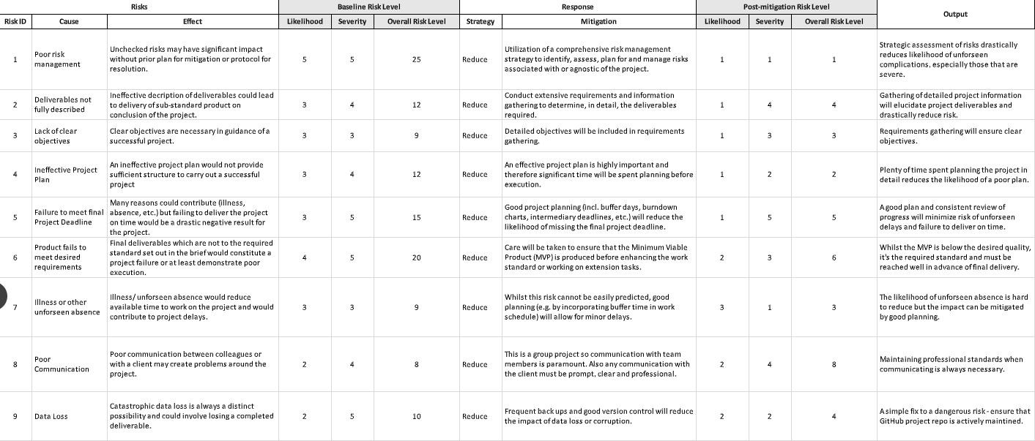
RISK ANALYSIS

Slide 11
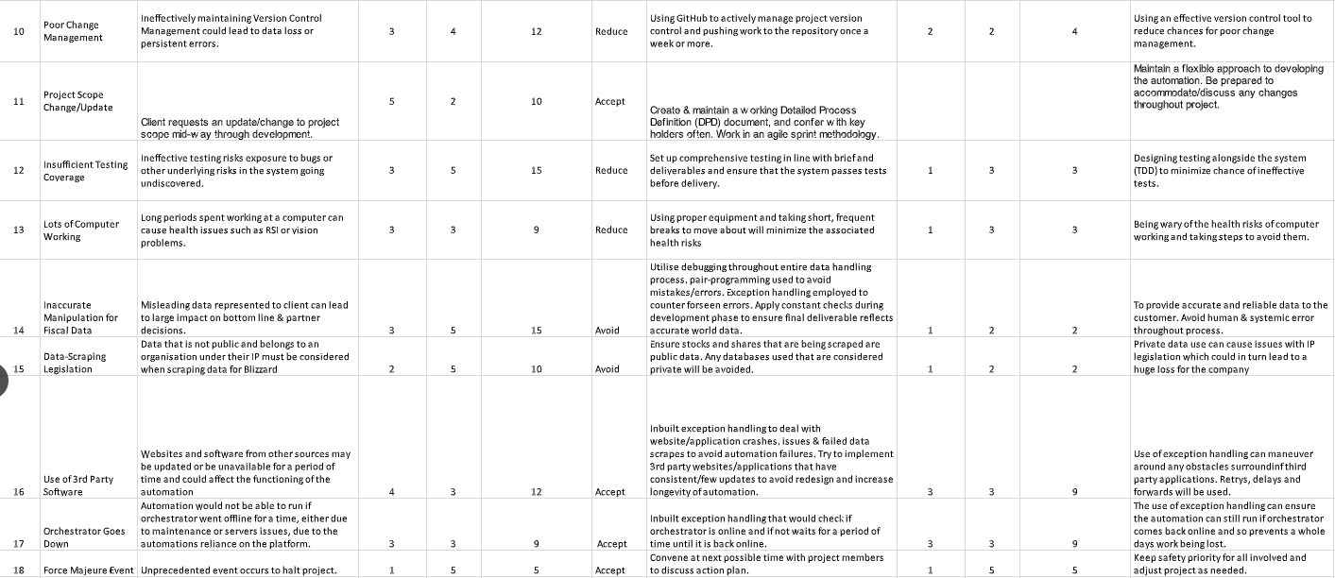
...CONTINUED

Slide 12
TRELLO BOARD
RACI MATRIX

Slide 13
PROCESS ANALYSIS

Slide 14
DPD

Slide 15
03
AUTOMATION DEMONSTRATION

Slide 16
EXCEPTIONS/BLOCKERS
WEBSITE SELECTORS
EXCEL USER INTERFACE
REFramework TESTING
ORCHESTRATOR

Slide 17
WHAT WENT WELL...
STREAMLINE
WEEKLY REPORT
SHARED PROCESS DESIGN
STRATEGY
TIME MANAGEMENT
TEAMWORK
TESTING INSIGHTS

Slide 18
THANKS!
Any Questions?

